Slide 1
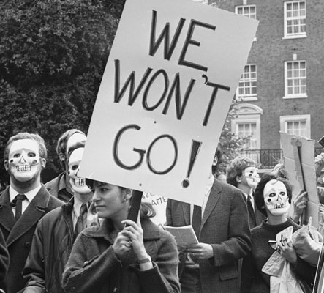
Realism and Pacifism

Slide 2
Realism
Realists argue that war is a non-moral activity – actions such as killing or stealing may be wrong for individuals, but have no application to nations in times of war.
A country does not therefore, have to have moral reasons to start a war or when it is carrying it out.

Slide 3
Realists give a number of reasons for this point of view
There is no real moral authority over nations telling them how to act.
To survive, a nation has to look after its own interests.
The threat of war and war itself make it impossible for any nation to do anything but act in its own interest – there is no time to do anything else.

Slide 4
However, even if Realists do not accept moral principles, they can still act in accordance with them, as it is often more practical to do so (eg. treat prisoners of war well).

Slide 5
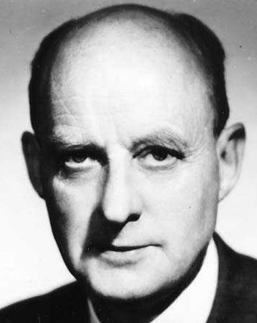
Christian Realism
Reinhold Niebuhr argued that war is evil and the result of human sinfulness, but that it may be necessary to prevent greater evils. He saw the importance of justice in societies, and of creating systems of justice; so Christians sometimes have to support the use of force to restrain evil and prevent greater injustices.

Slide 6
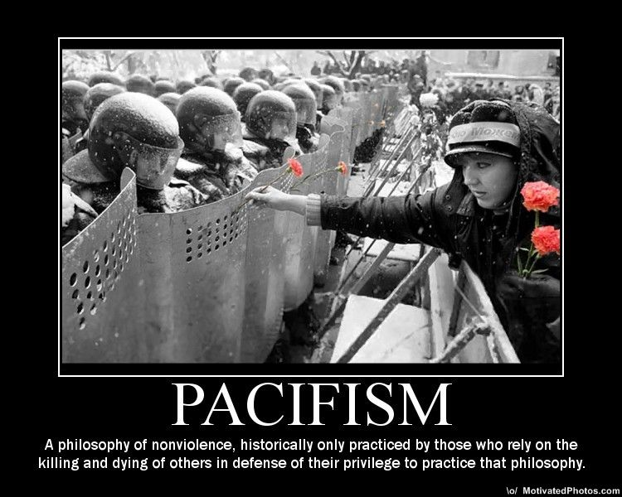
Pacifism
Pacifists reject all war in favour of peace. The use of force is always wrong, even in self-defence, and so pacifism rejects both the Just War theory and Realism.

Slide 7
Absolute Pacifism
Absolutism Pacifism says it is never right to kill another human being, no matter what consequences of not doing so might be, even loss of life.
This may be a religious belief or even a secular one. Absolute pacifists see violence as totally unacceptable.

Slide 8
Religious Pacifism
Pacifism was particularly strong in the early Church. However, from the fourth century, this became the minority view.

Slide 9
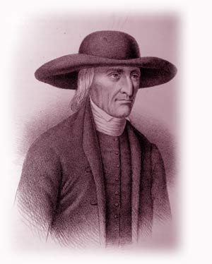
The Quakers
This is a Protestant Christian group who are opposed to all warfare. There are other such groups e.g.. Mennonites, the Bruderhof Brethen. Most of these groups would not be against the state defending itself, but would not take part in active military service.

Slide 10
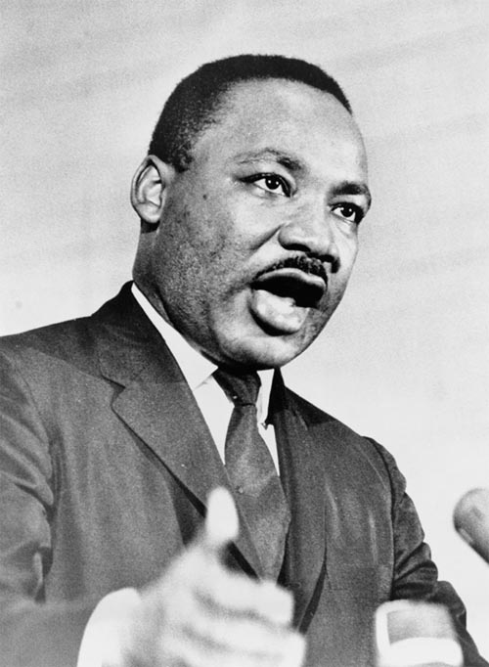
Pacifism does not mean doing nothing., but often encompasses non-violent direct action. The most well-known example of this was Martin Luther King Jr., who used forceful language, non-violent resistance, strikes, peaceful protest and civil disobedience in the struggle for racial equality in the USA.
This eventually led to his assassination.

Slide 11
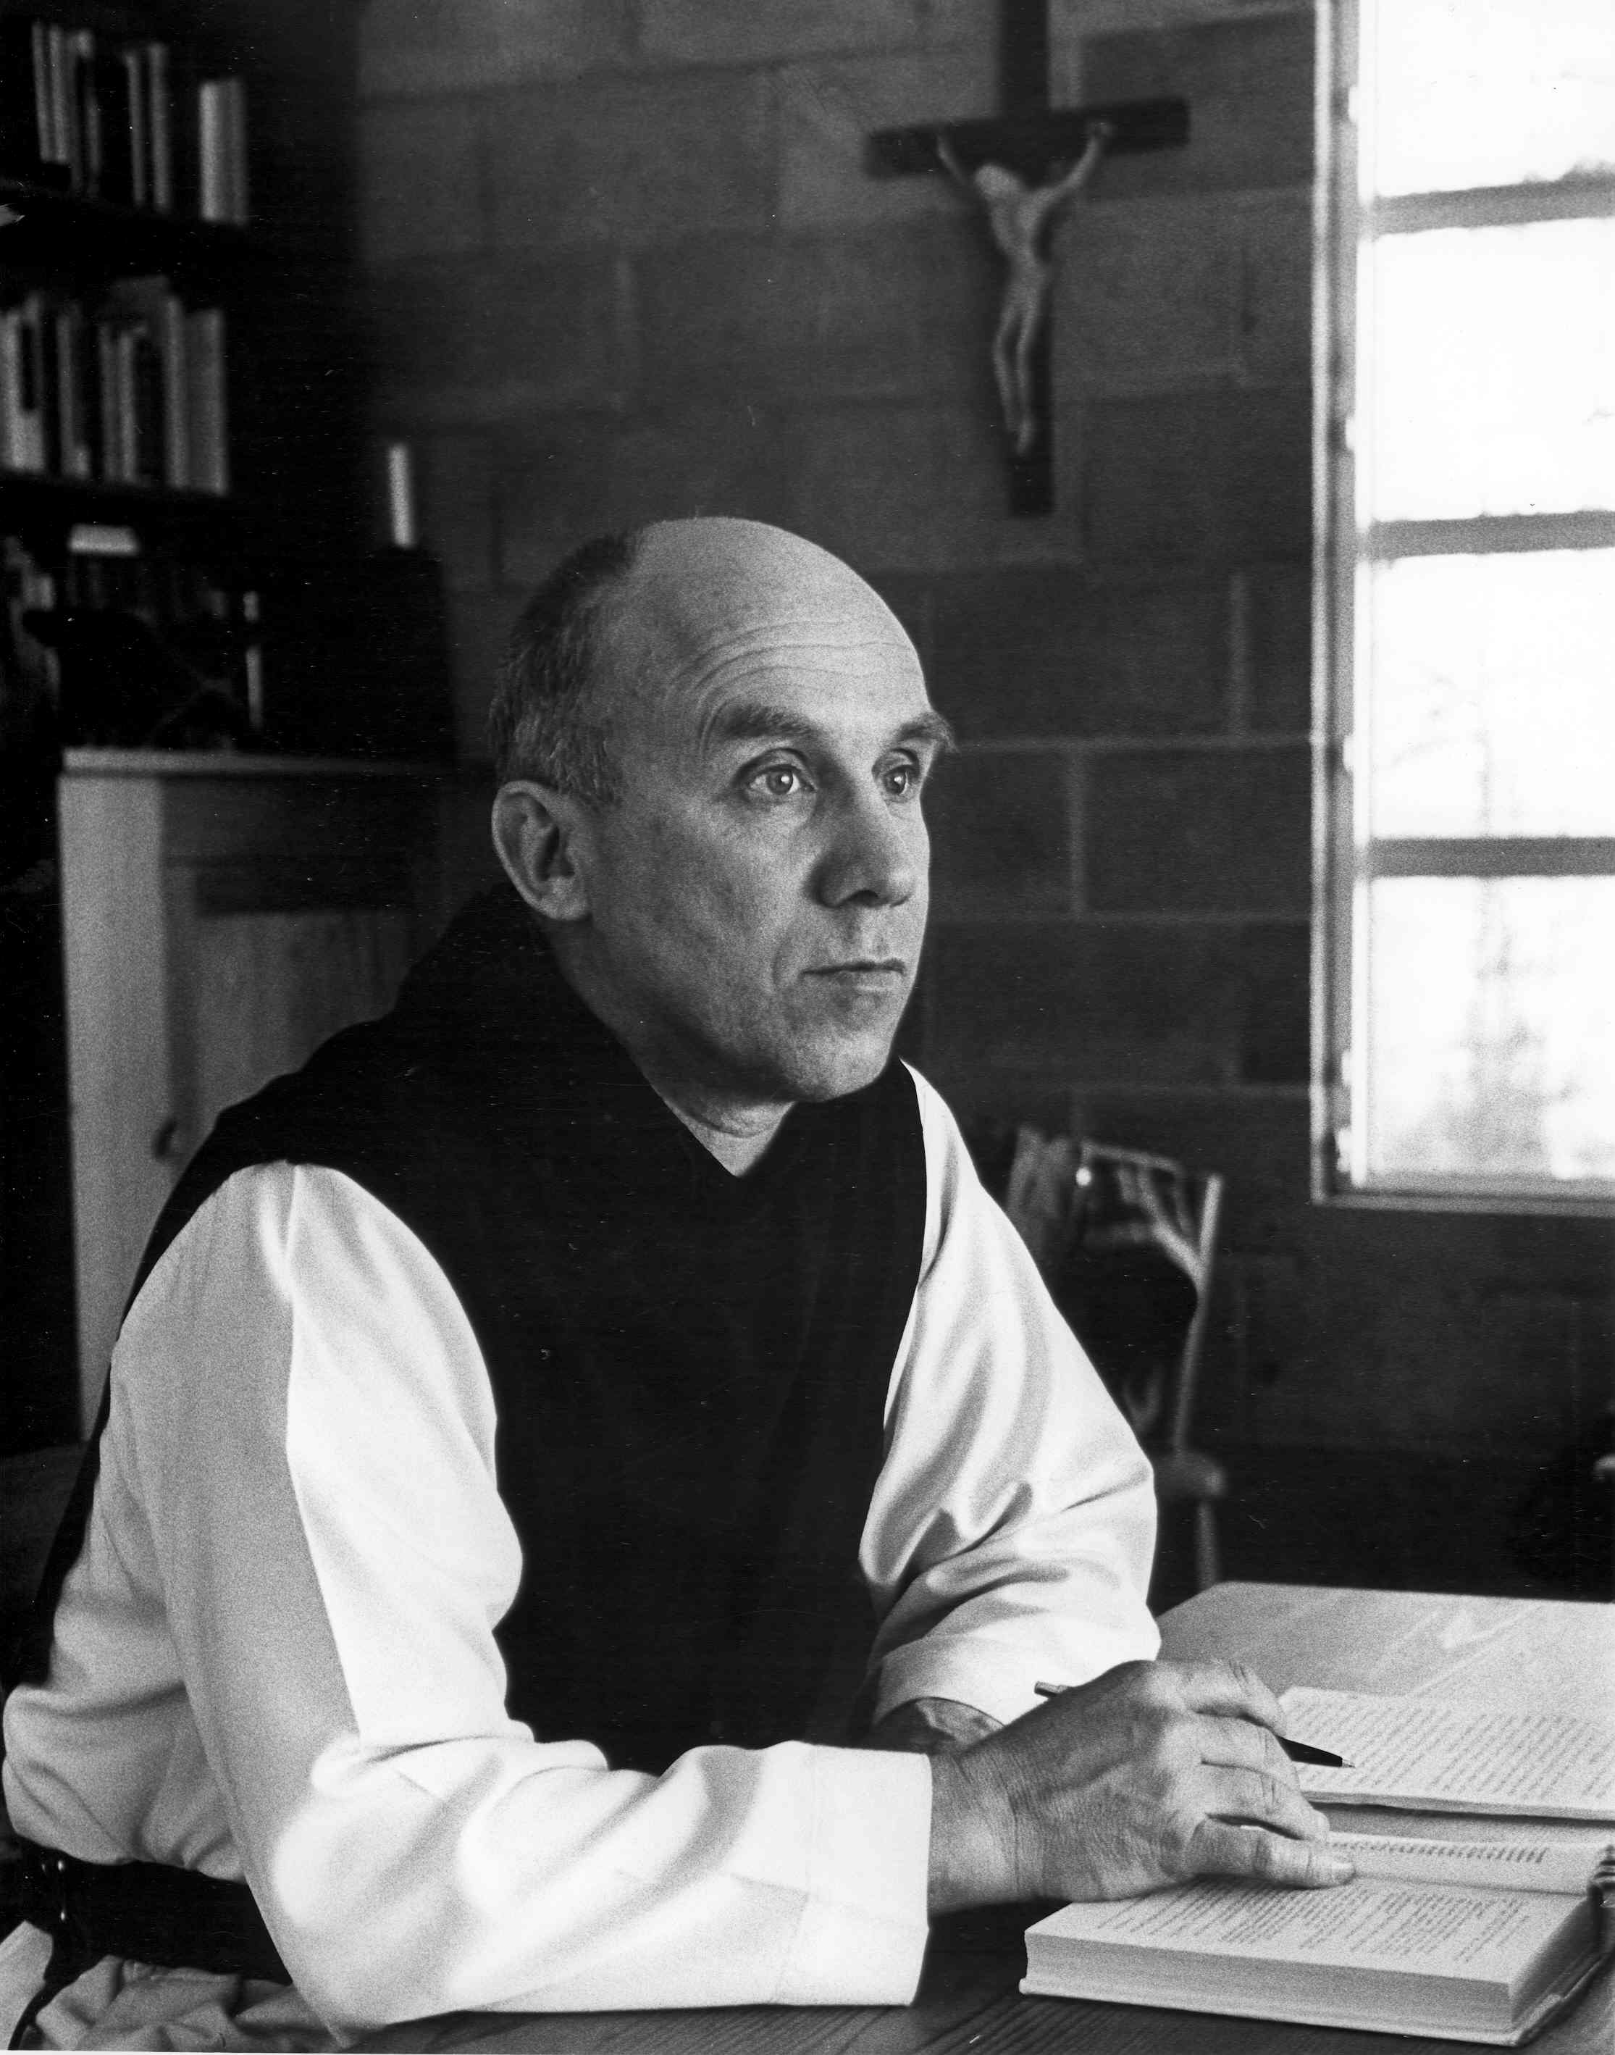
Many Christians in mainstream Christian denominations are also pacifists. Thomas Merton, a Catholic monk, influenced many people, by his renouncement of violence. Catholic pacifism is now more common.

Slide 12
Contingent Pacifism
Contingent pacifism is not opposed to war on absolute grounds, but on contingent grounds – war as we know it cannot be waged in a morally acceptable way. In other words, all wars today involve killing of the innocent, and this is morally unjustifiable.
Contingent pacifists accept war in some circumstances, such as self-defence, but as long as innocents are not killed. This makes war sometimes justifiable in theory, but not in practice.

Slide 13
Contingent pacifists look at each case to see if there are justifiable ways to fight the war. However, it is not possible to know in advance whether a proposed war will not kill any innocent people.
Contingent pacifists are against violence and war in principle, but accept there may be times when war is the lesser of two evils.

Slide 14
Preferential Pacifism
Preferential pacifism is a preferential option over violence. Preferential pacifists choose this option partly because war has been so destructive historically.
Sometimes preferential pacifism has to taken a back seat to the welfare of the oppressed. For example, Dietrich Bonhoeffer, who was a pacifist, took part in the plot to assassinate Hitler, as was later hanged for this.

Slide 15
A final point
Pacifism therefore, is not just one view. There are different sorts and degrees of pacifism, but they all include the view that war and violence are unjustified and that conflicts should be settled in a peaceful way.
Pacifism is seen more than opposition to violence and war; it must also include the promotion of justice and human rights.

Slide 16
Strengths of pacifism
It is clear cut – it opposes all forms of violence.
It follows the teaching of Jesus, which pacifists see as ignored in the Just War Theory.
It follows the historical position of the early Church.
It promotes the absolute value of human life.
Isn’t the best way to achieve peace in the world simply to be peaceful?

Slide 17
Weaknesses of pacifism
We do not live in a world based on pacifism and, as G.E.M. Anscombe points out, pacifism is wrong because it denies the right of self-defence.
The state has a duty to protect its citizens.
Pacifism allows evil to dominate.

Slide 18
‘Pacifism is immoral.’ Discuss. (10 marks)
Yes
No
Some people appear to be evil (e.g. the Nazis + Holocaust) and will not be affected by non violent resistance.
Denies rights of the individual to protect themselves.
The state has a duty to protect its citizens.
Follows the teachings of Jesus – Christians therefore would see Just War as being moral.
Promotes absolute value of human life.
Better theory: Realism???

