Slide 1
10.1 Exam Revision
Aim: To revise chapter 10.1 in preparation for the exam

Slide 2
Thinking task…
Write down three ways in which God is like a Father.
Write down two ways in which God is not like a Father.

Slide 3
In Pairs:
Revise the Next Slide Ready for a Test…

Slide 4
God the Father
Believing in God as a Father means:
Christians have a relationship with God
God can be turned to in times of need
The Lord’s Prayer tells us God is like a father as it begins ‘Our Father’ and shows he will provide for his children.
The importance of belief in God as a Father:
Jesus called God his Father. The teachings of Jesus are key to the Christian faith.
It is taught in the Apostles’ Creed and the Catechism.
It explains why God sent Jesus to save people from sin.

Slide 5
Exam Questions
b) Do you think Christians should call God Father? Give two reasons for your point of view.
d) “God is not like a Father.”
Do you agree? Give reasons for your answer.
Give reasons why someone might disagree with you.

Slide 6
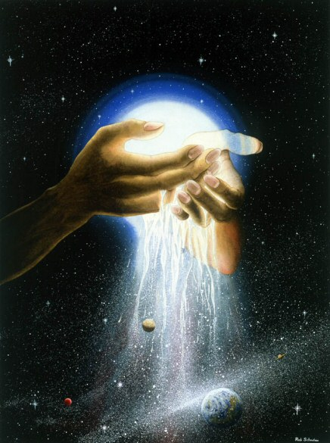
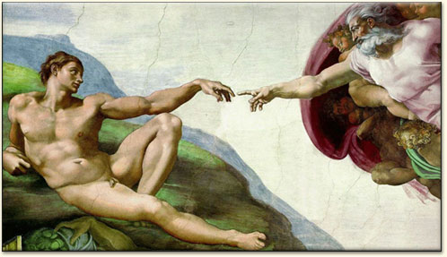
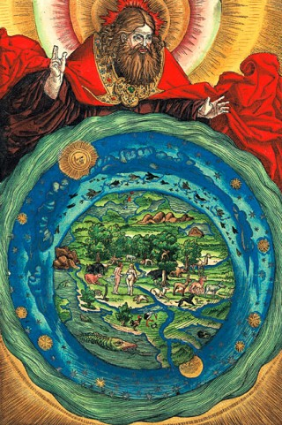
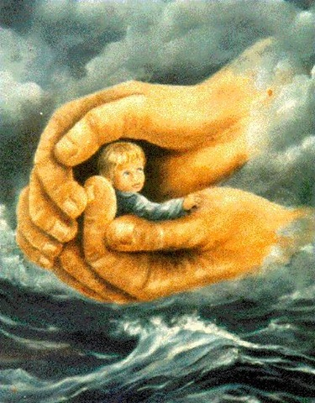
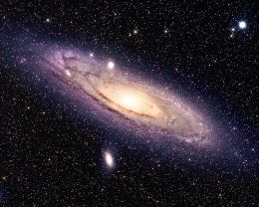
Images of God as Creator: Which do you think represents God best?

Slide 7
Read the information and answer the questions:
It is important to Christians that God is the creator of the world as it shows his power, his love and the relationship between God and humans. It is also important because if God made the world, it means humans should view it as holy and treat the world and creatures with respect.
Answer these questions:
Should Christians accept the Biblical account of creation, should they accept evolution or are both ideas acceptable? Explain your answer.
What does belief in God as creator, show Christians about their relationship with God?

Slide 8
Exam Questions
What is Salvation?
Do you think God made humans in his own image? Give two reasons for your answer.
Explain what it means for Christians to believe in God as a creator.
‘It does not matter whether God made the Universe or not.’
Do you agree? Give reasons for your answer.
Give reasons why some people would disagree with you.

Slide 9
Jesus the Son
Write down these facts about Jesus and explain why they are important:
Conceived by the power of the Holy Spirit and born of the Virgin Mary.
Was crucified under Pontius Pilate, died and was buried.
Descended into Hell.
On the third day he rose again.
Jesus ascended into Heaven and is seated at the right hand of the Father.
Jesus will come again to judge the living and the dead

Slide 10
Characteristics of Jesus
These four references to Jesus are taken from the Apostles’ Creed:
Jesus – The name means ‘God saves.’ What does this tells us about Jesus?
Christ – The term comes from ‘Christos’ and is comparable to the Hebrew title ‘Messiah’. It means something similar to king. What was Jesus meant to bring with him?

Slide 11
Characteristics of Jesus
The only Son of God – Although Christians believe we are all God’s children, this highlights the specialness of Jesus. What does this tell us about Jesus?
Lord – This is God’s title from the Old Testament. What does this recognise about Jesus?

Slide 12
Why is believing Jesus is the Son of God important?
Only the Son of God could bring salvation from sin and give people the chance to enter heaven.
Believing in Jesus as the Son of God gives Christians the chance to see the love shown by God’s Son, leading them to share God’s love with their neighbours.
Believing in Jesus is the Son of God is a teaching of the Creeds and the Catechism of the Catholic Church.
Only God’s Son could institute the Mass which brings Christ into people’s lives today.

Slide 13
Questions
What is compassion? (2)
Do you think Jesus’ birth was a miracle? Give two reasons for your answer. (4)
Explain why it is important for Christians to believe that Jesus is the Son of God? (8)
“Jesus was a very special person but He is not God.”
Do you agree? Give reasons for your answer. (3)
Give reasons why someone would disagree with you. (3)

Slide 14
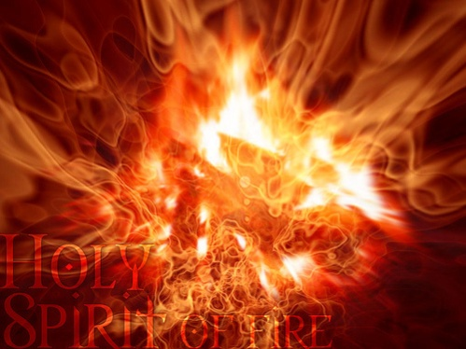
The Holy Spirit
Explain each symbols significance
Dove
Wind
Fire

Slide 15
Quick questions
What is the role of the Holy Spirit in the Trinity?
What do Christians believe about the Holy Spirit and the Bible?
What is the Holy Spirit’s relationship to the higher levels of the Church (the Magisterium)?
How does the Holy Spirit affect the sacraments?
What does the Holy Spirit offer Christians?

Slide 16
Acts 2: 1-4
When the day of Pentecost came, they were all together in one place. Suddenly a sound like the blowing of a violent wind came from heaven and filled the whole house where they were sitting. They saw what seemed to be tongues of fire that separated and came to rest on each of them. All of them were filled with the Holy Spirit and began to speak in other tongues as the Spirit enabled them.

Slide 17
The Importance of Believing in the Holy Spirit
It is the third part of the Trinity.
Through certain sacraments (baptism and reconciliation) it removes people’s sin.
It inspires the teachings of the Church and explain why the Church should be obeyed.
It gives guidance to the Church when electing the Pope and other authority figures.
The gifts of the Holy Spirit allow people to be happy and live a good Christian life.
It supports people, allowing them to follow their religious calling (vocation).

Slide 18
Key terms – Sin:
Keyword:
Repentance – the act of being sorry for a wrongdoing and deciding not to do it again.
Define the terms ‘original sin’ and ‘personal sin’.
Define the terms ‘mortal sin’ and ‘venial sin’.
Give an example of a mortal sin and a venial sin.

Slide 19
Salvation
Salvation is brought about by:
Receiving the sacraments of baptism and confirmation.
Receiving the sacrament of reconciliation.
Receiving the sacrament of the Eucharist.
Leading a Christian life.
Why do each of these things help bring salvation?

Slide 20
The Importance of Sin and Salvation
The idea of sin is important because it tells Christians why they must live a good life.
Salvation is important because without it, people’s sins would stop them from having a relationship with God.
This means that people would go to purgatory or Hell. Salvation helps people get to Heaven.
Salvation is also important because it was the purpose of Jesus’ life, death and resurrection.
It also explains why the sacraments of baptism, reconciliation and the Mass are so important.

Slide 21
Exam questions:
Do you think we need salvation from sin? Give two reasons for your answer. (4)
Explain why salvation is important to Christians. (8)
‘Salvation cannot be achieved just by going to Mass.’
Do you agree? Give reasons for your answer. (3)
Give reasons why some might disagree with you. (3)

