Slide 1
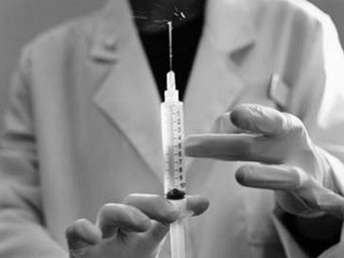
Euthanasia

Slide 2
Review these key words:
Active Euthanasia
Passive Euthanasia
Voluntary Euthanasia
Involuntary Euthanasia

Slide 3
Personhood
When does someone become a person?
A question that different ethical positions will answer differently...
Can we consider someone in a PVS a person?

Slide 4
Sanctity of Life
Catholic.
Declaration of Euthanasia (1980). This recognise that suffering can be so great (physically and psychologically) it can make one want to remove it. However, it also says ‘suffering has a great place in God’s plan of salvation’.
Against Natural Law and the first primary precept (preservation of life).

Slide 5
Doctrine of Double Effect
It is the intention which is important when using painkilling drugs which have a secondary effect of shortening life.
A patient may refuse treatment if it is through extraordinary means (over and above the essential) – and if the means of saving life is disproportionate to the pain suffered.
How are extraordinary means to be interpreted?

Slide 6
Personhood: Different Philosophers Views:
Using your handout take notes on the views of:
Germain Grisez and Joseph Boyle
Daniel Maguire
Peter Singer

