Slide 1
Living the Christian Life Revision
LO: to be a 10.4 expert

Slide 2
Key Words
Vocation in daily life
Vocation and holy orders
Ten Commandments
St Vincent de Paul
Sermon on the Mount as a guide for Living
Sermon on the Mount and Money
Why Catholics Relieve Poverty and Suffering
The Golden Rule

Slide 3
Vocation and Daily Life
How
By choosing caring profession e.g. doctor, care worker, nurse, counselor, they can show love for God.
Marriage and bringing up children in a Christian family means the parents act as disciples through teaching the word of God.
Showing love of thy neighbor show love of God.
Being honest at work, being fair, standing up for justice etc.
Why
Vocation is about the whole of life and serving God in all they do.
Jesus’ final command to his disciples was to ‘baptise all nations’. This means they show their faith in all they do.
Vocation is a call to love God and love thy neighbour which is the greatest commandment.
It cannot be restricted to church or Sundays – it must be in everything a Christian does.
BACK

Slide 4
St Vincent de Paul
St Vincent de Paul Society helps relieve suffering in the UK by:
Visiting the lonely/bereaved, depressed and the housebound.
Organising holiday schemes for poor, broken, family carers, poor families etc.
Organising furniture stores which can be used when housing the homeless.
Organising housing associations to provide affordable housing the disadvantaged.
BACK

Slide 5
Key Words
Write the definitions in your book:
Active Life
Displaying Religion
Holy Orders
The Laws of Moses
Vocation
The evangelical Counsels
BACK

Slide 6
The Golden Rule Treat others as you want to be treated.
How they use the Teachings
To judge people, you must expect to be judged in the same way. So, before criticising someone else, one must look at the way you act.
Concentrate on trying to improve yourself rather than picking on the things other’s do wrong.
One simple rule is easier than lots of rules.
Why they use the Teachings
Jesus, as God’s sons is the best person to show Christians when to judge.
If Jesus gives the golden rule it must be good.
If Christians are going to be judged this teaching might help.
The golden rule helps Christians work out how to behave in difficult situations.
BACK

Slide 7
The Sermon on the Mount and Money
Why Christians Use These Teachings
Jesus is the best person to show Christians the relationship between God and money.
Possessions and money do not last forever. By concentrating on eternal good, one can have eternal life.
The teachings remind Christians how easily they can be possessed by wealth and forget about God.
It’s more important to love you neighbour.
How Christians Use Teachings as a Guide about Money
It’s more important to gain spiritually than financially.
They learn what to do with their money.
They should not make money their God.
Trust God rather than worry about the future.
BACK

Slide 8
Ten Commandments
How Christians Use the 10 Commandments
Through prayers and worship Christians show they follow the first three commandments.
Many Christians do not swear – especially using God’s name.
Honouring the Sabbath day means going to Mass every Sunday.
Christians do not steal, lie, commit adultery, desire other people’s things.
Why Christians Use the 10 Commandments
The 10 Commandments is a precise list of rules from God to help Christians know how to behave.
If they follow the first 3 commandments they will be worshipping the one God of the Apostles’ Creed.
Following the last 7 will give Christians good relationship with their neighbours.
The commandments promote marriage and family life.
BACK

Slide 9
Vocation and Holy Orders
How men show vocation by taking Holy Orders
By taking Holy Orders, men copy the work of the Apostles.
Men promise to serve Jesus just as Jesus served people.
Men witness their faith.
They try and build the Kingdom of God.
Why men take Holy Orders.
They have a special calling from God to devote their lives to God.
It is a calling that most priests can’t ignore.
It is a way men can share in the mission that Christ entrusted to his Apostles.
The want to serve God in the church by celebrating the sacraments.
BACK

Slide 10
Sermon on the Mount as a Guide for Living
How Christians use the 10 Commandments
Jesus teaches anger can lead to murder, therefore you must seek forgiveness and reconciliation.
Married Christians follow Jesus’ teaching that lustful thoughts are as bad as teaching adultery.
If you re-marry after divorce you are committing adultery.
Christians use teachings about an eye for an eye to become pacifists.
Why Christians use the 10 Commandments
These teachings have more detail than the 10 Commandments.
It says the old Jewish ways have been fulfilled by the new law of Jesus.
It explains thoughts and feelings are as important as actions.
If Jesus thought disciples needed teaching, it must be important for today.
BACK

Slide 11
Why Catholics Help Relieve Poverty and Suffering in the UK
Why Catholics Should help People
Jesus said riches must be used to help the poor.
All humans are equal and all things on Earth have been given for people to help each other.
The parable of the Sheep and the Goats says people should help each other.
It’s a way of loving your neighbour.
BACK

Slide 12
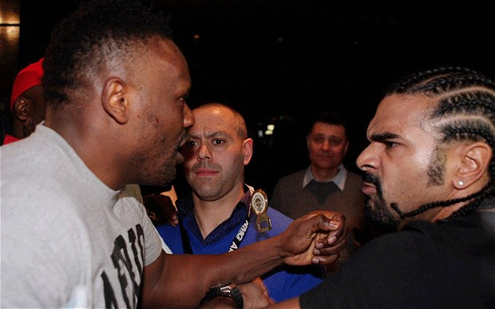
“Christians should never fight back”

